Slide 1
The Kubernetes WebLogic Revival
Martien van den Akker
Frank Brink
2019

Slide 2
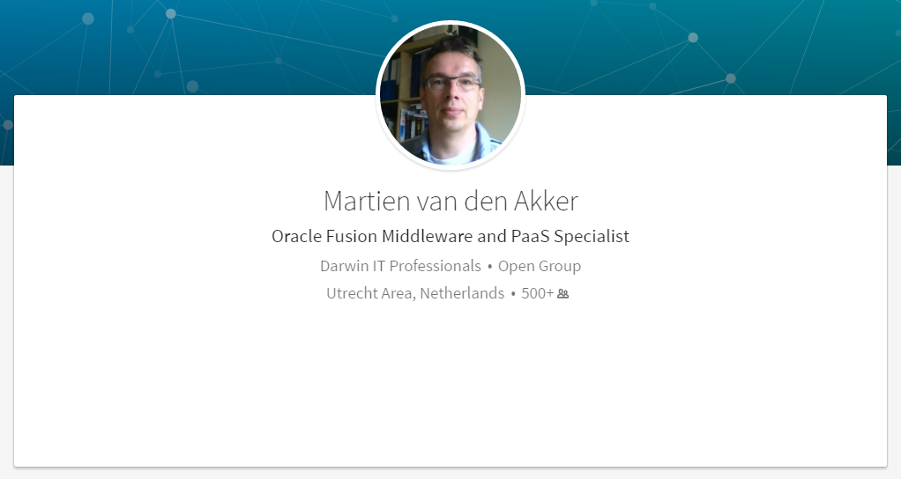
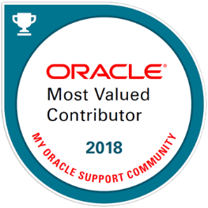

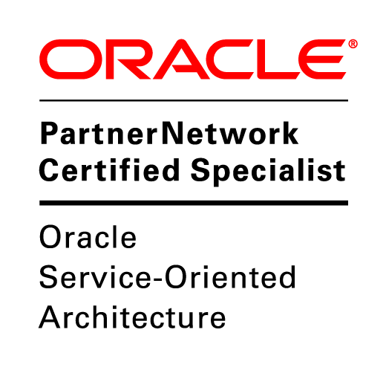
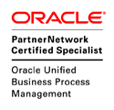
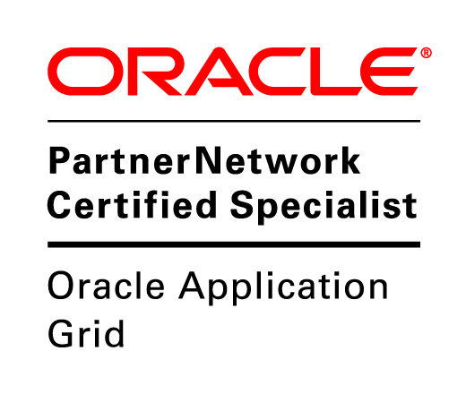


Who I am
martien.van.den.akker@darwin-it.nl
@Makker_nl

Slide 3
Agenda
1
What is Weblogic 12c?
Virtualization - Containers
Weblogic: what’s next?
Deploy Weblogic in Kubernetes
Topology models
Configuration overrides
HA/DR
Tooling
2
3
4
5
6
7
8
Notes:
3

Slide 4
What is Weblogic 12c?

Slide 5
JEE/Jakarta EE
Java Enterprise Edition – Jakarta Enterprise Edition
Set of specifications on top of Java SE
API’s and Frameworks such as
JDBC Datasources
JNDI (Java Naming Directory Interface)
JMS (Java Messaging Service)
WebServices/REST Services
Servlets/Java Server Pages/Java Server Faces
Reference: GlassFish Server OS, JEE 8 fully certified

Slide 6
Weblogic
Fully supports JEE 7 as of 12.2.1, JEE 8 as of 14.1
Commercial App Server, by BEA Systems
Acquired by Oracle in 2008
Strategic Application Server, replacing OC4J
(Oracle has 3 JEE AppServers…)
Very rich support for (amongst others)
Clustering
JDBC
High Availability
JMS
Diagnostics and Monitoring
REST & SOAP

Slide 7

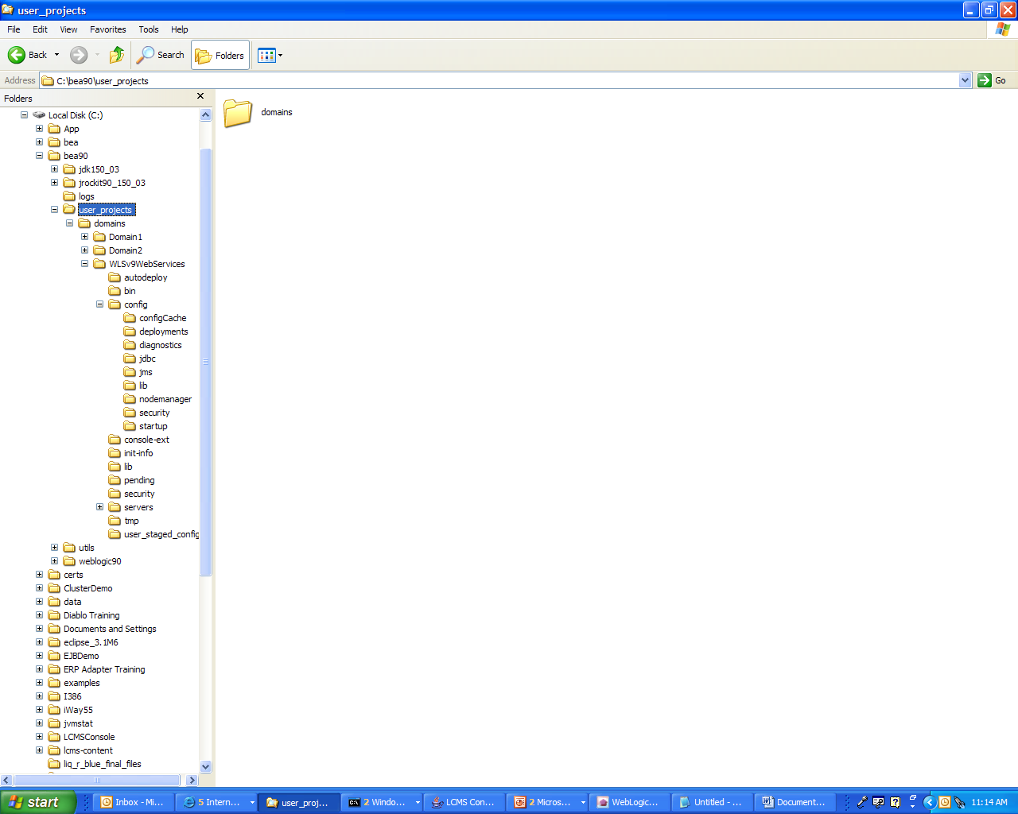
Domain Diagram
Domain
Cluster
Nodemanager Properties
Domain log
LOG
Machine 1
Get configuration
at startup.
Managed
server 1
Send
critical domain
notifications.
LOG
Local logging
Console
Administration
server
Log domain messages
Managed
server 2
Nodemanager Properties
Machine 2
GET/SET
LOG
Local logging
Monitor/ update
Managed
server 3
Configuration
repository
LOG
Local logging
Notes:
Domain Diagram
The diagram in the slide shows the critical components of a domain. A domain is an arbitrary logical administration unit that is managed by one administration server. A domain can encompass clusters in different geographies.
The administration server is responsible for providing configurations for all servers of a specific domain and for logging critical (configurable) notifications of the domain’s servers. It is also responsible for monitoring managed servers. A managed server is responsible for performing the business logic.
A managed server gets its configuration from the administration server at boot time. The managed server is then able to execute independently of the administration server. The administration server registers itself with each managed server so that it can receive critical notifications and run-time server state changes. Note that the only configuration folders and files that play a role are those of the administration server. The configuration folders and files of the managed servers are normally ignored because they download all configuration information from the administration server.
Configuration management is implemented through Java Management Extension (JMX). The communication between the managed servers and the administration server is via Remote Method Invocation (RMI), which also uses JMX.
Note: The diagram in the slide is a simplification; all the servers would be monitored by and updated from the administration server. Also, all the managed servers retrieve their configuration information at startup time from the administration server and log critical data to the administration server.

Slide 8
Weblogic HA Setup
Host 1 (Machine 1)
Host 2 (Machine 2)
Managed Server Domain (On Shared Storage)
Administration
server
Administration
server
Node Manager (per domain)
Node Manager (per domain)
Managed Server Domain (Clone from Admin Server Domain, Local Storage)
Managed Server Domain (Clone from Admin Server Domain,
Local Storage)
Cluster
Managed
server 1
Managed
server 2
Node Manager (per domain)
Managed
server 3
Managed
server 3
Node Manager (per domain)

Slide 9
Weblogic Clustering
Share resources (Deployments, Datasources, JMS)
Supports Service Migration and Whole Server Migration
12c+:
Dynamic Clustering, based on Server templates, supports scale up, scale down
Simpeler JMS Configuration, based on Dynamic Clusters
Chooses MS as Cluster Master to control cluster member health
Declarative configuration

Slide 10
Virtualization - Containers

Slide 11
History of Deployments
Deployments as in installation/configuration of software
OS - infrastructure
Database, Middleware – Platforms – binaries and instances
Custom applications – Java, Apex, Webservices, …
Before 1995
Install/configure OS on bare metal: Unix, Linux, AIX, Windows
(silent) installs of platform software vs. Interactive deployment of custom applications
Characteristics: fixed resource allocation per bare metal/OS (memory, cpu, storage)
1995-2015
Virtualization of OS (VMWare, VirtualBox)
Scripting installs and configuration of platform software (e.g. wlst)
Automation of application software (e.g. ANT)
Characteristics: dynamic resource allocation on (OS) virtualization layer
After 2015
Automation of Iaas, Paas and custom application software in context of CD/CI through virtualization and scripting
Characteristics: dynamic resource allocation on lowest virtualization layer

Slide 12
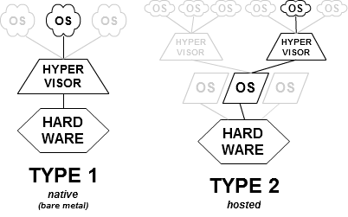
Hypervisor Characteristics
Virtualization requires an hypervisor
Hypervisor
A virtual machine monitor (VMM) is computer software, firmware or hardware
Creates and runs virtual machines (called guest machines)
Optimized (as in dynamic) management of resources: CPU, Memory, NIC and Disks
Term (coined in 1970!) comes from supervisor of the supervisor (latter aka kernel of the OS)
Most popular Hypervisors
Xen
VMWare server, workstation
Oracle VM, Virtual Box
Windows Hyper-V
Two types of hypervisors: bare metal and hosted
Docker requires a hypervisor and an OS
copyright ©2019 Darwin IT-Professionals B.V.
12

Slide 13
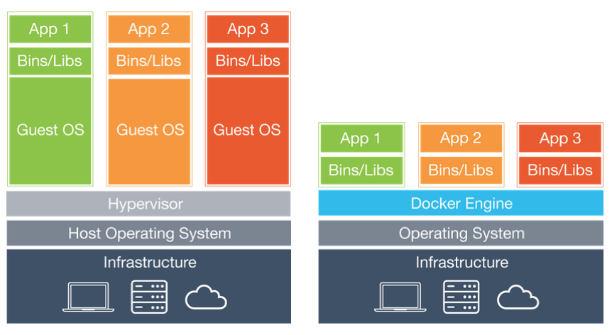
Virtualization Types
App 1
App 2
App 1
App 2
App 1
App 2
App 1
App 2
Docker
OS 1 Windows
OS 2 Linux
Guest OS 1 Windows
Guest OS 2 Linux
Guest OS 2 Windows, Linux
Hypervisor
Oracle VM
VMWare esxi, Hyper-V
Hypervisor
Virtual Box VMWare Server/WS
Hypervisor
Virtual Box, Hyper-v
Hyper-V or Virtual Box
Host OS
Windows, Linux
Host OS
Windows, Linux
Host OS
Windows, Linux
HW Infrastructure
CPU, Storage, Network, Memory
HW Infrastructure
CPU, Storage, Network, Memory
HW Infrastructure
CPU, Storage, Network, Memory
HW Infrastructure
CPU, Storage, Network, Memory
0. No Virtualization Bare Metal
1. Type 1 Virtualization Bare metal Hypervisor
2. Type 2 Virtualization Hosted Hypervisor
3. Docker
copyright ©2019 Darwin IT-Professionals B.V.
13
Notes:
No Virtuallization
Apps running on top of an OS like Windows, Linux, Mac OS
Fixed resource allocation
Opposite of lean, mean, speedy, re-usable, portable, …
No Hypervisor – resource management by OS (kernel)
HyperVisor Type 1 (bare metal HyperVisor)
Apps running on top of a guest OS/Hypervisor/HW aka Baremetal hypervisor
Examples: Oracle VM Server, VMWare esxi, Windows Hyper-V
Hypervisor contains small/minimalized OS
1 or more applications are running within a single OS with possiible dependancies/collasions
HyperVisor Type 2 (hosted HyperVisor)
Apps running on top of a guest OS/Hypervisor/host OS/HW aka hosted hypervisor
Examples: VMWare Server/Workstation, Oracle Virtual Box
Hypervisor runs on top of OS
1 or more applications are running within a single OS with possiible dependancies/collasions
Allow multiple (different) OS’s on a single hypervisor
Docker Containers
(containerized) apps running on top of Docker/Hypervisor/(host/guest) OS/HW
Requires a hyperviosr (type 1 or type 2) and an OS
Each application is running independant of other applications but sharing the OS resources

Slide 14
Docker on a Windows Platform Deployment Alternatives
App 1
App 2
App 1
App 2
App 3
Docker for Windows
Docker for Linux
OS
Windows
Guest OS Linux (e.g. Ubuntu Oracle linux)
Hypervisor (T1)
Hyper-v
Vagrant
Hypervisor (T2)
Virtual Box
Host OS
Windows
HW Infrastructure
CPU, Storage, Network, Memory
HW Infrastructure
CPU, Storage, Network, Memory
3a. Docker for Windows with Hyper-V (Bare Metal Virtualization)
3b. Docker for Linux with Virtual Box (Hosted Virtualization)
copyright ©2019 Darwin IT-Professionals B.V.
14

Slide 15
Preference for Hosted Virtualization on a Windows box (3b)
Preferred deployment reasons (type 2 hypervisor)
Alignment of host os with underlying Docker os: Linux
No portability issues like directory names/paths, upper/lowercase
Extended resource management within Virtual Box (versus Hyper-V)
Additional management capabillities of Docker installed on a Linux platform versus the Windows Docker service
re-allocate the docker runtime (storage) environment
Despite the disadvantages
Additional host Windows os as the Virtual Box platform
copyright ©2019 Darwin IT-Professionals B.V.
15

Slide 16
Docker versus Virtualization Types 1 &2
App 1
App 2
App 1
App 2
Docker
Guest OS 1 Windows
Guest OS 2 Linux
OS
Windows, Linux
Hypervisor VMWare, Oracle VM/VirtualBox
Hypervisor VB, Hyper-V
OS
Windows, Linux
OS
Windows, Linux
HW Infrastructure
CPU, Storage, Network, Memory
HW Infrastructure
CPU, Storage, Network, Memory
Virtualization Type 1&2
Docker
copyright ©2019 Darwin IT-Professionals B.V.
16

Slide 17
Docker Characteristics
Released in 2013
Virtualization on app level (versus on OS level) Sharing the OS across the containers
Based on Linux libs/OS Note there is also a (not as popular) Windows Docker flavour
Open-Source
Requires a hypervisor and an OS
copyright ©2019 Darwin IT-Professionals B.V.
17

Slide 18
Docker Popularity
Speed: smaller footprint, enabling quick and lightweight deployment and startup
Portability/re-use capability: they can run on any OS (e.g. Windows, Linux distributions)
Scale: by spinning additional containers (could be managed by Kubernetes)
Micro-services support: opposite of monolithic technology like hypervisors/bare metal)
Independancy: pack your container app with all required libraries
Popularity of Open-Source back in 2013
Leaner and meaner than hypervisors
Support of DevOps principles: emphasizes agility, flexibility and scalability in software delivery
Automating the creation of runtime environments through coding (e.g. Vagrant, Docker Build)
Massive availability of containerized apps in public registries (e.g search for Tomcat > 10k hits)
copyright ©2019 Darwin IT-Professionals B.V.
18

Slide 19
Docker & Cloud
Oracle Cloud provides a Paas like Container cloud service
VM Docker installation and engine
VM to store your (own) containers
(private/Public) registry to publish your containers
UI like Kitematic to manage all the above
AWS, Google and Azure provides similar container cloud services and additional tooling (e.g. Kubernetes)
It fits perfectly in the scaling capabilities of Docker
Spin additional containers when needed
For containers in the cloud you basically need a (linux) image with a Docker install/engine - thus easily to be provided by a - simple - Iaas service
Added value of CCS: Additional tooling
Threads: Not the latest Docker release
copyright ©2019 Darwin IT-Professionals B.V.
19

Slide 20
Weblogic: what’s next?

Slide 21

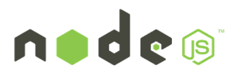






WebLogic, Coherence and Cloud Native Trends
Industry trends
Microservices, serverless
Private and public clouds
Containers, orchestration frameworks
WebLogic, Coherence customer demand
Leverage cloud neutral infrastructure
Integrate with new tools and services
Evolve WebLogic, Coherence for these environments
Blockchain
WebLogic
Coherence
copyright ©2019 Darwin IT-Professionals B.V.
21

Slide 22

Oracle Enterprise Java Strategy
Operator
WebLogic
Coherence
Evolve Products to Meet Customer Demand
Migrate to Kubernetes on premise
Tools for migration and management
Support existing and new applications
Migrate to Kubernetes on Oracle Cloud
Leverage management tools on OCI
Availability, security, scaling, low-cost
Integrate with Microservices
Flexibility for developers
Evolve and manage applications
Oracle Cloud and Other Clouds
Migrate
Operator
WebLogic
Coherence
WebLogic
Coherence
Physical & VMs On Premise
Kubernetes on Premise
copyright ©2019 Darwin IT-Professionals B.V.
22

Slide 23


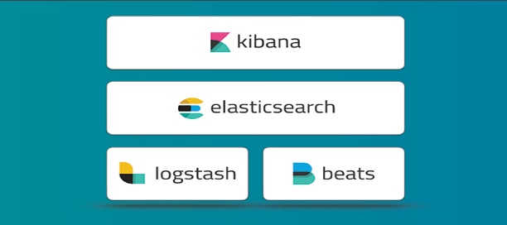
WebLogic on Kubernetes - Building Blocks
Operator
Docker and CRI-O certification
Docker images, Dockerfiles, examples
WebLogic Kubernetes certification
How-to, best practices
Value add integration
Management: Operator
Monitoring: Exporter for Prometheus
Migration: Deploy tooling
Logging: Exporter for Elastic Stack
Image Creation: WebLogic Image Tool
WebLogic
Coherence
copyright ©2019 Darwin IT-Professionals B.V.
23

Slide 24
WebLogic Domain in Kubernetes- Domain Custom Resource
We create a Kubernetes Resource Object for the WebLogic domain.
This is a data structure representation of the WebLogic domain in Kubernetes.
Domain Custom Resource allows you to declare or specify the desired state of the resource.
Allows the Kubernetes API server to begin serving the custom resource object.
The WebLogic Kubernetes Operator is a controller that is always looking at the Domain Custom Resource and tries to match the actual state to this desired state.
Domain Custom Resource
Meta Data: Name of Resource, Namespace, Labels, …
Admin Server: Node Ports to expose, Volumes, …
Cluster: Number of Replicas (Managed Servers), …
Domain: Image to base the Domain containers, Domain in PV or in Image, K8S secrets, Logs to pod
Managed Servers: non-clustered MS
Server Pod: Java Options, Start Policy (Lifecycle control)
Events:
copyright ©2019 Darwin IT-Professionals B.V.
24

Slide 25
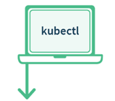



Why build the WebLogic Kubernetes Operator?
Contains built-in knowledge about how to perform lifecycle operations on a domain
Uses Kubernetes APIs to automate lifecycle operations.
Operator
Kubernetes
Orchestrate WebLogic
Manage
Pods
WLS Cluster
POD 1
POD 2
POD 3
POD 4
POD 5
POD 6
AS
MS
MS
MS
MS
MS
Kubernetes Cluster
copyright ©2019 Darwin IT-Professionals B.V.
25
Notes:
Operator is an application-specific controller that extends Kubernetes to create, configure, and manage instances of complex applications. The WebLogic Kubernetes Operator follows the standard Kubernetes Operator pattern,
Some of the things that the Operator does to simplify management and operations on the WebLogic domain and deployments
Create RBAC roles to manage Kubernetes resources on behalf of the WebLogic domain. Authorization to start/stop/.restart/create new domain.
Invokes the right Kubernetes APIs to start or stop servers, domains, clusters
the WebLogic Diagnostic framework Auto-scale setting rules in when the rule is met the Operator will invoke K8S API to scale the WebLogic cluster
When there is a new patched WebLogic image or a Application update initiate a rolling restart of the WebLogic domain

Slide 26
WebLogic Kubernetes Operator
1
Manages lifecycle operations (start, stop, scale, rolling restart, etc.) in Kubernetes
2
Automate configuration, e.g. clustering, channels/ports, configuration overrides
3
Supports standard k8s idioms like sidecars, init containers, custom resources
Open source and fully supported https://github.com/oracle/weblogic-kubernetes-operator
copyright ©2019 Darwin IT-Professionals B.V.
26

Slide 27
Deploy Weblogic in Kubernetes

Slide 28



WebLogic Domain in Kubernetes Operator
Customer Tenancy
Repository
WLS Domain Image
Domain Home in Image
Create OKE Cluster
Operator
Image
Kubernetes
Kubernetes
Build Image
Kubernetes Cluster
Kubernetes
copyright ©2019 Darwin IT-Professionals B.V.
28

Slide 29
Create Secrets
Customer Tenancy
Repository
Create secrets Wls and Docker Image Repository (OCIR)
WLS Domain Image
Operator
Image
Kubernetes
Kubernetes
Kubernetes Cluster
Secrets
Kubernetes
copyright ©2019 Darwin IT-Professionals B.V.
29

Slide 30

Install Weblogic Operator using Helm
Customer Tenancy
Repository
WLS Domain Image
Operator
Image
Kubernetes
Kubernetes Cluster
Secrets
Operator
Kubernetes
copyright ©2019 Darwin IT-Professionals B.V.
30

Slide 31
Install/Config Treafik LoadBalancer
Customer Tenancy
Repository
WLS Domain Image
Operator
Image
Kubernetes
Kubernetes Cluster
Secrets
Operator
Kubernetes
copyright ©2019 Darwin IT-Professionals B.V.
31

Slide 32
Possibly create persistent volume
Customer Tenancy
Repository
WLS Domain Image
Operator
Image
Kubernetes
Kubernetes Cluster
Secrets
Operator
Kubernetes
copyright ©2019 Darwin IT-Professionals B.V.
32

Slide 33
Create a Domain.yaml
Customer Tenancy
Repository
WLS Domain Image
Operator
Image
Kubernetes
Kubernetes Cluster
Secrets
Operator
Install Domain inputs (yaml)
Kubernetes
copyright ©2019 Darwin IT-Professionals B.V.
33

Slide 34
Apply Domain.yaml to CustomResource
Customer Tenancy
Repository
WLS Domain Image
Operator
Image
Kubernetes
Kubernetes
Domain CR
Kubernetes Cluster
Secrets
Operator
Install Domain inputs (yaml)
kubectl apply …
Kubernetes
copyright ©2019 Darwin IT-Professionals B.V.
34

Slide 35
Operator creating pods
Customer Tenancy
Repository
WLS Domain Image
Operator
Image
Kubernetes
Domain CR
Kubernetes Cluster
Secrets
Operator
WebLogic Domain(s)
WLS Cluster
POD 1
POD 2
POD 3
POD 4
POD 5
POD 6
AS
MS
MS
MS
MS
MS
Kubernetes
Logs
copyright ©2019 Darwin IT-Professionals B.V.
35

Slide 36
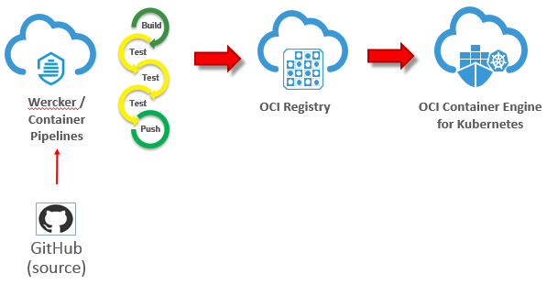
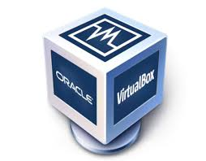
GitHub, Wercker, OCI Registry & OKE
Oracle Cloud Developer Services
Push
Kubernetes
copyright ©2019 Darwin IT-Professionals B.V.
36

Slide 37
Topology models

Slide 38
2 Topology Models
Options | Domain in PV/C | Domain in Image
Domain Topology Changes | Apply to domain in PV (wlst online) | New Image
Configuration Changes (tunables, credentials, …) | Change configuration in domain in PV | Overrides Only
Patching | New Image | CI/CD (new image)
Application Updates | Apply to domain in PV | CI/CD (new image)
Management of PV/PVC | More complex (filesystem shared per domain) | Simple (not shared, per server)
Administration Console | App deployments and Configuration Changes, can not do lifecycle mgt. | Monitoring and Diagnosis. Invalidate configuration changes.
Log Persistence | Supported (PV, Pod FS, Elastic Stack, Standard Out) | Supported (PV, Pod FS, Elastic Stack, Standard Out)
HA Across Availability Domain | Limited (requirement for shared PV) | Supported (No requirement for shared PV)
DR across Regions | Supported Active/Passive (like on Premise user responsible for sync domain config across DC) | Supported Active/Passive (easier, user does not need to sync domain config across DC)

Slide 39
Which model should I use?
The key difference is how updates are handled
Java updates
WebLogic patching
WebLogic configuration changes
Application updates
Are you fully embracing the CI/CD "DevOps" model and intend to manage change through that process?
E.g. create new images every time there is an update.
Are you making changes to configurations and deployments in running systems?
E.g. run WLST online to dynamically change your domain configuration.

Slide 40
Configuration overrides

Slide 41
Configuration Overrides
WebLogic Images containing Application, domain configuration, resources are immutable.
These Docker images must be portable
Development -> Testing -> Production.
Follow the customer’s CI/CD process.
Therefore, customers need a mechanism to override certain domain configuration
E.g. Provide data source URL and credentials

Slide 42
Domain Introspection and Config Override Generation
Introspection Job
WLS Domain Image
Domain
Customer provided override templates
Scan domain configuration for topology and to validate
Generation of final configuration overrides
Operator
Operator overrides

Slide 43
User Configuration Overrides
Typical attributes for overrides include:
User names, passwords, and URLs for:
JDBC datasources
JMS bridges, foreign servers, and SAF
Network channel public addresses:
For remote RMI clients (T3, JMS, EJB, JTA)
For remote WLST clients
Debugging
Tuning (MaxMessageSize, etc.)

Slide 44
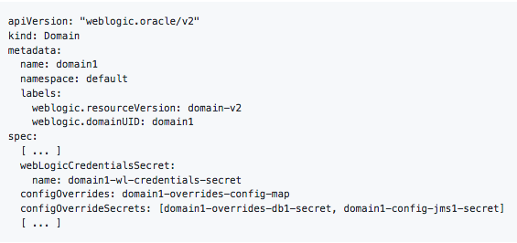
Configuration Overrides
Create a Kubernetes configuration map that contains:
Override templates
Create Kubernetes secrets that contains:
Data source username and password.
Set your domain CR
Config map.
Secret with the Config Override
Start or restart your domain.

Slide 45
Assign Pods to Nodes

Slide 46
Assigning WebLogic Pods to Nodes
Use Node Selector to constrain a pod to only be able to run on particular nodes.
Assign a label (key=value) to the node:
kubectl label nodes kubernetes-foo-node-1 licensed-for-weblogic=true
Edit the Domain Custom Resource at the domain/cluster/server level and assign key:value nodeSelector.
Edit Domain CR
Domain Custom Resource
serverPod:
nodeSelector:
licensed-for-weblogic: true

Slide 47

Assigning WebLogic Pods to Nodes
Assign pods to Nodes based on resources, e.g. CPU and Memory usage
A Pod is scheduled to run on a Node only if the Node has enough CPU resources available.
Edit Domain CR
Domain Custom Resource
serverPod:
resources:
requests:
memory: "8Gb"
cpu: "250m"
limits:
memory: "128Mi"
cpu: "500m"`

Slide 48

Inter-Pod Affinity and Anti-Affinity
Which K8s nodes to schedule or re-schedule pods with respect to other WebLogic pods
Possible types of Node affinity/anti-affinity:
Preferred (soft affinity)
Required (hard affinity)
Match labels for Affinity/Anti-affinity
Operator: In
Operator: Exists
Operator: NotIn
Operator: DoesNotExist
Edit Domain CR
serverPod:
affinity: podAntiAffinity:
preferredDuringSchedulingIgnoredDuringExecution:
- labelSelector:
matchExpressions:
- key: "weblogic.clusterName"
operator: In
values: - cluster-1
topologyKey: "kubernetes.io/hostname"

Slide 49
WLS POD2
Operator
Schedule
Node 1
Node 2
Node 3
WLS POD1
weblogic.clusterName
Licensed-for-weblogic
Licensed-for-weblogic
nodeSelector:
licensed-for-weblogic: true
affinity: podAntiAffinity:
preferredDuringSchedulingIgnoredDuringExecution:
- labelSelector:
matchExpressions:
- key: "weblogic.clusterName"
operator: In

Slide 50
Operator
Node 1
Node 2
Node 3
WLS POD1
WLS POD2
weblogic.clusterName
weblogic.clusterName
Licensed-for-weblogic
Licensed-for-weblogic
nodeSelector:
licensed-for-weblogic: true
affinity: podAntiAffinity:
preferredDuringSchedulingIgnoredDuringExecution:
- labelSelector:
matchExpressions:
- key: "weblogic.clusterName"
operator: In

Slide 51
WLS POD3
Operator
Schedule
Node 1
Node 2
Node 3
WLS POD1
WLS POD2
weblogic.clusterName
weblogic.clusterName
Licensed-for-weblogic
Licensed-for-weblogic
nodeSelector:
licensed-for-weblogic: true
affinity: podAntiAffinity:
preferredDuringSchedulingIgnoredDuringExecution:
- labelSelector:
matchExpressions:
- key: "weblogic.clusterName"
operator: In

Slide 52
Operator
Node 1
Node 2
Node 3
WLS POD1
WLS POD3
WLS POD2
weblogic.clusterName
weblogic.clusterName
weblogic.clusterName
Licensed-for-weblogic
Licensed-for-weblogic
nodeSelector:
licensed-for-weblogic: true
affinity: podAntiAffinity:
preferredDuringSchedulingIgnoredDuringExecution:
- labelSelector:
matchExpressions:
- key: "weblogic.clusterName"
operator: In

Slide 53
HA and DR in Kubernetes

Slide 54
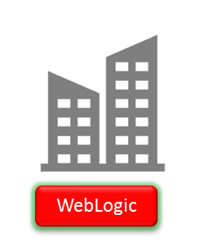



WebLogic High Availability
WebLogic High Availability across Data Centers with WebLogic Stretch Clusters.
Span a WebLogic domain across several Availability Domains
Single Kubernetes Cluster
AD 1
AD 2
AD 3
WebLogic domain

Slide 55
WebLogic Disaster Recovery
WebLogic DR across Regions made easier
WebLogic domain image contains complete domain configuration
State needs to be externalized to Database
Region A
WLS Domain image
Region B

Slide 56
Tooling

Slide 57

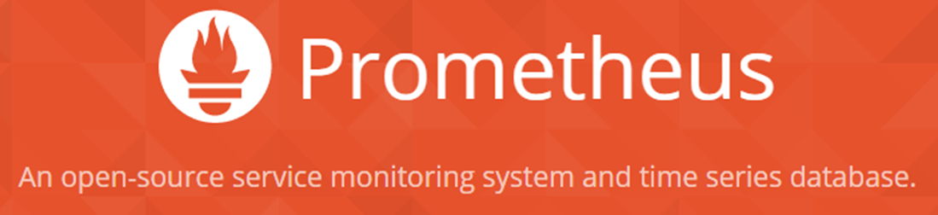
WebLogic Monitoring Exporter
Monitoring Exporter enables Prometheus monitoring of WebLogic
Standard monitoring tools can be used for monitoring WebLogic
Grafana Dashboards used for visualization
Prometheus auto-scaling of WebLogic cluster
Prometheus and Grafana example GitHub Sample
Operator
Scale
WLS
Kubernetes
Kubernetes
Monitor
WebLogic
WebLogic
WebLogic
MS
MS

Slide 58
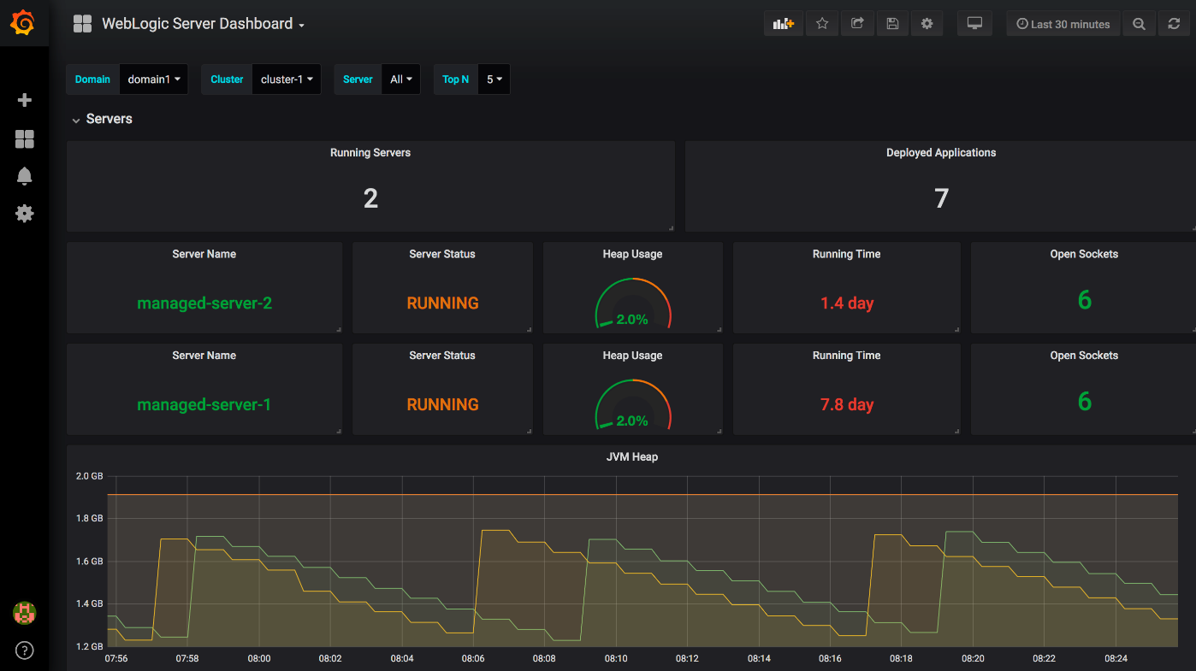
Out of the Box Grafana Dashboards

Slide 59
WebLogic Deploy Tooling
Introspect domains
WebLogic 10.3.6, 12.1.3, 12.2.1.X
Create a model (yaml) of the domain
Migrate existing domains and applications Upgrade (if required) to 12.2.1.X
Customize and Validate configuration to meet Kubernetes requirements
Create domains in Docker image GitHub Sample
WebLogic Deploy Tooling
Domain Model
WebLogic
WebLogic
WebLogic

Slide 60

WebLogic Logging Exporter
Logging Exporter enables exporting WebLogic server logs to the Elastic Stack
Store logs in the Elastic Stack
Search and analyze logs in Elastichsearch
Display logs in dashboards in Kibana
Integrate with FluentD (future)
GitHub weblogic-logging-exporter
Operator
Kubernetes
Kubernetes
WebLogic
WebLogic
WebLogic
MS
MS

Slide 61
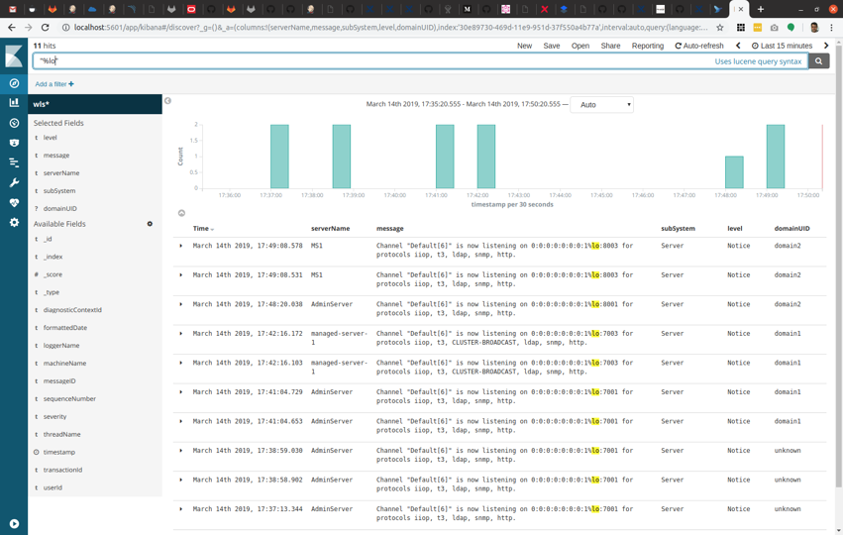
Kibana Dashboards

Slide 62

Patching WL Image with WebLogic Image Tool
Future
Repository
My Oracle Support
Operator
Image
Download
p29135930 & p27117282
WLS Domain Image
Kubernetes
WLS Image Tool
WLS 12.2.1.3 Binary Image
Use cases
Apply patches p29135930 & p27117282
Build image from scratch
WLS 12.2.1.3
JDK 8_u201
OL 7.5
p29135930 & p27117282
WebLogioc 12.2.1.3 binaries
Server JRE
Build image from already existing image
Oracle Linux
Apply patches p29135930 & p27117282
WLS 12.2.1.3 patched Binary Image
WLS 12.2.1.3 Binary Image from Repository
p29135930 & p27117282
WLS 12.2.1.3 Binary Image
Build domain image based on WLS 12.2.1.3
WLS 12.2.1.3
p29135930 & p27117282
Domain yaml model & Application binaries
With WDT build a domain image with application
WLS Domain Image Patched
WLS 12.2.1.3 patched Binary Image

Slide 63
Demo Weblogic within OKE cluster

Slide 64

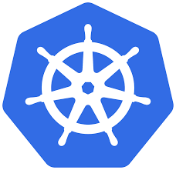
OKE Cluster and its VCN context
ORACLE CLOUD DATA CENTER REGION (Frankfurt)
AVAILABILITY DOMAIN-1
AVAILABILITY DOMAIN-2
AVAILABILITY DOMAIN-3
10.0.10.4
10.0.10.2
10.0.10.3
OKE-1
OKE-2
OKE-0
OKE Cluster
Wkr Security List
Regional Private SUBNET A,10.0.10.0/24
130.61.12.8
LB
LB Security List
Regional Public SUBNET A,10.0.20.0/24
OKE VCN, 10.0.0.0/16
Medreck8s Compartment

Slide 65
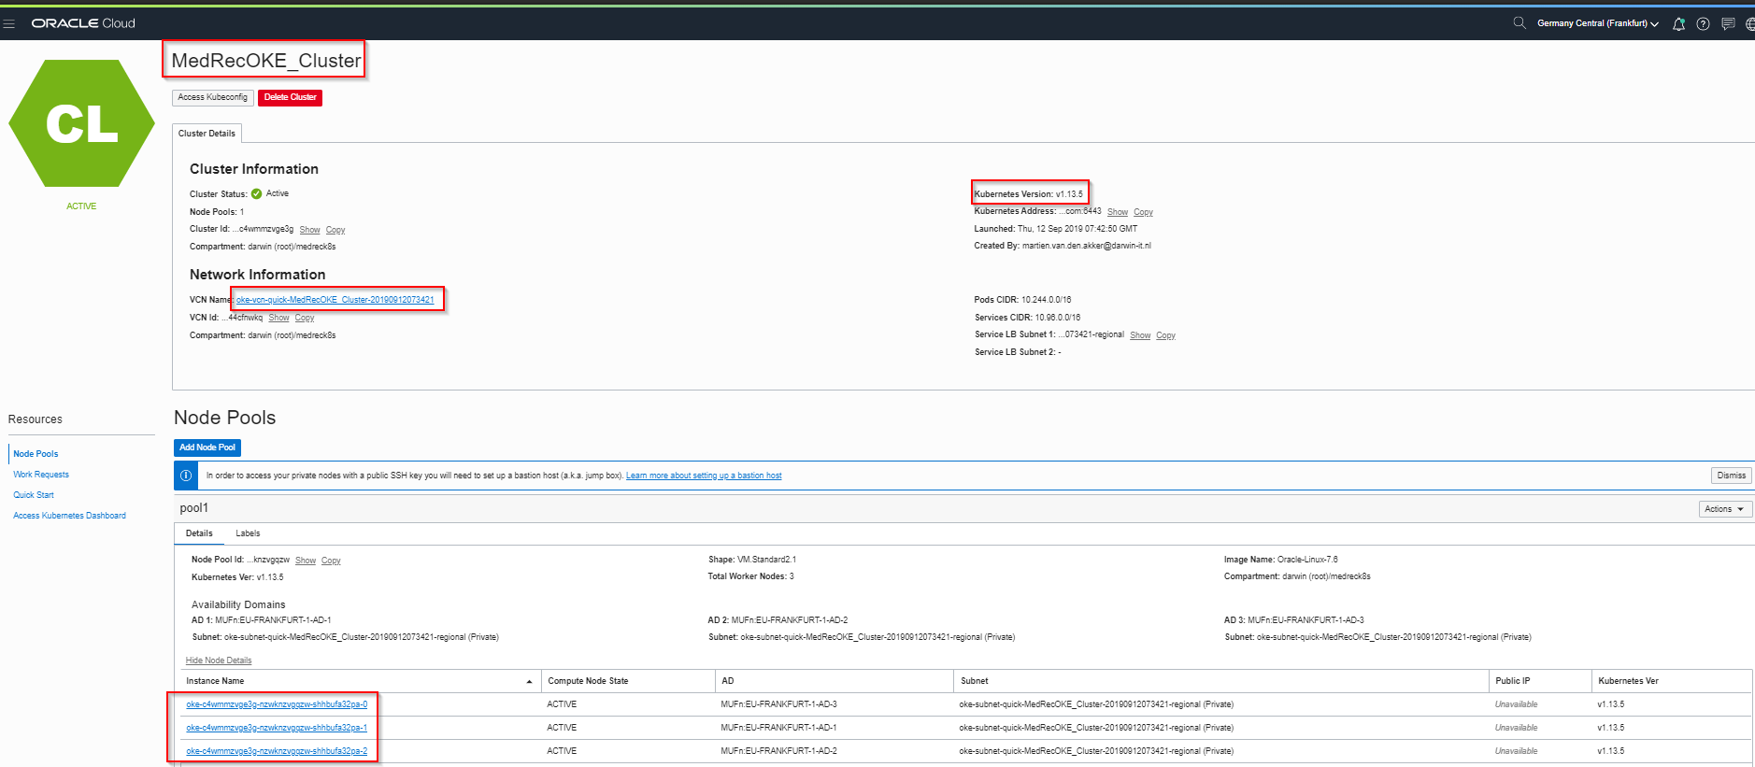
OKE Cluster within OCI Console
ORACLE CLOUD DATA CENTER REGION (Frankfurt)
AVAILABILITY DOMAIN-1
AVAILABILITY DOMAIN-2
AVAILABILITY DOMAIN-3
10.0.10.4
10.0.10.2
10.0.10.3
OKE-1
OKE-2
OKE-0
OKE Cluster
Wkr Security List
Regional Private SUBNET A,10.0.10.0/24
130.61.12.8
LB
LB Security List
Regional Public SUBNET A,10.0.20.0/24
OKE VCN, 10.0.0.0/16
Medreck8s Compartment

Slide 66
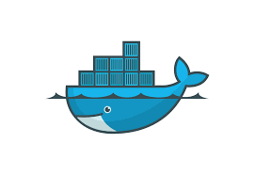
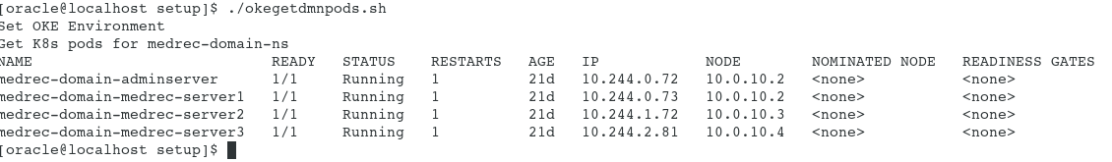
Weblogic running within an OKE Cluster
ORACLE CLOUD DATA CENTER REGION (Frankfurt)
AVAILABILITY DOMAIN-1
AVAILABILITY DOMAIN-2
AVAILABILITY DOMAIN-3
AdmSrv
10.244.2.45
10.0.10.4
10.0.10.2
10.0.10.3
Srv-2
10.244.0.56
Srv-3
10.244.1.40
Srv-1
10.244.2.46
OKE-1
OKE-2
OKE-0
OKE Cluster
Wkr Security List
Regional Private SUBNET A,10.0.10.0/24
130.61.12.8
LB
LB Security List
Regional Public SUBNET A,10.0.20.0/24
OKE VCN, 10.0.0.0/16
Medreck8s Compartment

Slide 67
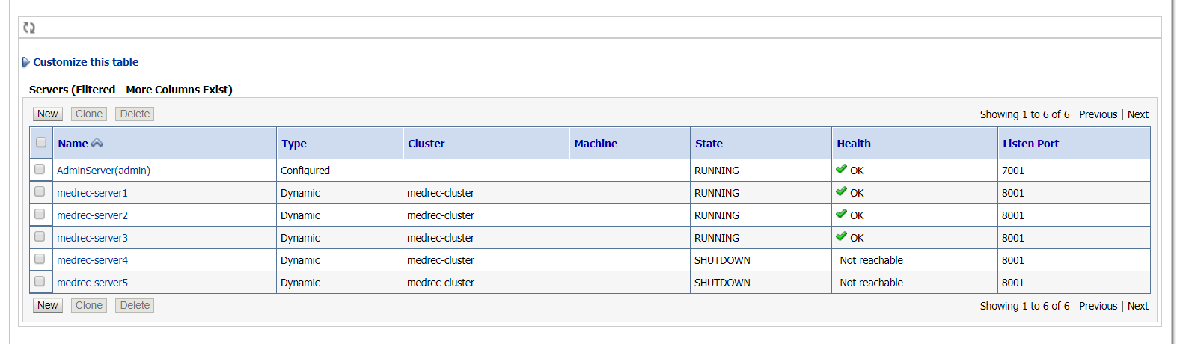
Managed servers within weblogic domain running on a OKE cluster
ORACLE CLOUD DATA CENTER REGION (Frankfurt)
AVAILABILITY DOMAIN-1
AVAILABILITY DOMAIN-2
AVAILABILITY DOMAIN-3
AdmSrv
10.244.2.45
10.0.10.4
10.0.10.2
10.0.10.3
Srv-2
10.244.0.56
Srv-3
10.244.1.40
Srv-1
10.244.2.46
OKE-1
OKE-2
OKE-0
OKE Cluster
Wkr Security List
Regional Private SUBNET A,10.0.10.0/24
130.61.12.8
LB
LB Security List
Regional Public SUBNET A,10.0.20.0/24
OKE VCN, 10.0.0.0/16
Medreck8s Compartment

Slide 68
How to access a managed database outside an OKE cluster?
ORACLE CLOUD DATA CENTER REGION (Frankfurt)
AVAILABILITY DOMAIN-1
AVAILABILITY DOMAIN-2
AVAILABILITY DOMAIN-3
AdmSrv
10.244.2.45
10.0.10.4
10.0.10.2
10.0.10.3
Srv-2
10.244.0.56
Srv-3
10.244.1.40
Srv-1
10.244.2.46
OKE-1
OKE-2
OKE-0
10.0.10.6
OKE Cluster
10.96.72.93
Wkr Security List
DBHost
Regional Private SUBNET A,10.0.10.0/24
LB Security List
130.61.12.8
LB
Regional Public SUBNET A,10.0.20.0/24
OKE VCN, 10.0.0.0/16
Medreck8s Compartment

Slide 69
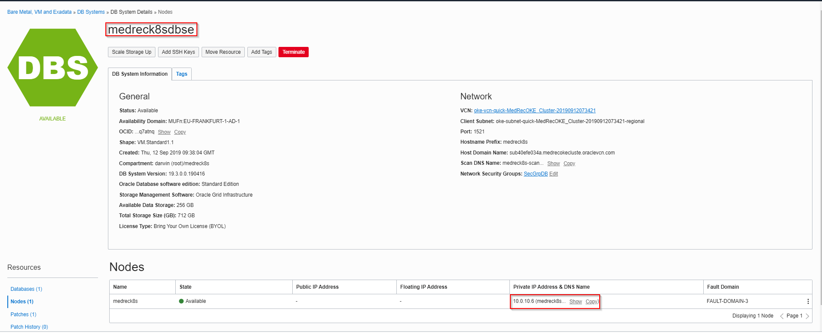
Running managed database in OCI console within same subnet as OKE cluster
ORACLE CLOUD DATA CENTER REGION (Frankfurt)
AVAILABILITY DOMAIN-1
AVAILABILITY DOMAIN-2
AVAILABILITY DOMAIN-3
AdmSrv
10.244.2.45
10.0.10.4
10.0.10.2
10.0.10.3
Srv-2
10.244.0.56
Srv-3
10.244.1.40
Srv-1
10.244.2.46
OKE-1
OKE-2
OKE-0
10.0.10.6
OKE Cluster
10.96.72.93
Wkr Security List
DBHost
Regional Private SUBNET A,10.0.10.0/24
LB Security List
130.61.12.8
LB
Regional Public SUBNET A,10.0.20.0/24
OKE VCN, 10.0.0.0/16
Medreck8s Compartment

Slide 70

Runtime access to a managed database via a k8s service
ORACLE CLOUD DATA CENTER REGION (Frankfurt)
AVAILABILITY DOMAIN-1
AVAILABILITY DOMAIN-2
AVAILABILITY DOMAIN-3
AdmSrv
10.244.2.45
10.0.10.4
10.0.10.2
10.0.10.3
Srv-2
10.244.0.56
Srv-3
10.244.1.40
Srv-1
10.244.2.46
OKE-1
OKE-2
OKE-0
10.0.10.6
OKE Cluster
medrecdbhostname sk8s service op 1521
10.96.104.28
Wkr Security List
DBHost
Regional Private SUBNET A,10.0.10.0/24
LB Security List
130.61.12.8
LB
Regional Public SUBNET A,10.0.20.0/24
OKE VCN, 10.0.0.0/16
Medreck8s Compartment

Slide 71
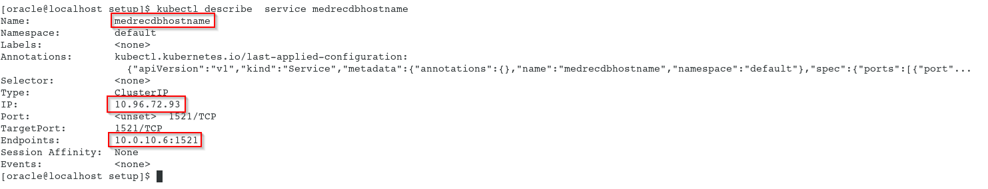
k8s service medrecdbhostname details with kubectl
ORACLE CLOUD DATA CENTER REGION (Frankfurt)
AVAILABILITY DOMAIN-1
AVAILABILITY DOMAIN-2
AVAILABILITY DOMAIN-3
AdmSrv
10.244.2.45
10.0.10.4
10.0.10.2
10.0.10.3
Srv-2
10.244.0.56
Srv-3
10.244.1.40
Srv-1
10.244.2.46
OKE-1
OKE-2
OKE-0
10.0.10.6
OKE Cluster
medrecdbhostname sk8s service op 1521
10.96.72.93
Wkr Security List
DBHost
Regional Private SUBNET A,10.0.10.0/24
LB Security List
130.61.12.8
LB
Regional Public SUBNET A,10.0.20.0/24
OKE VCN, 10.0.0.0/16
Medreck8s Compartment

Slide 72
Demo Down and Up Sizing a Weblogic Domain: more/less managed servers
ORACLE CLOUD DATA CENTER REGION (Frankfurt)
AVAILABILITY DOMAIN-1
AVAILABILITY DOMAIN-2
AVAILABILITY DOMAIN-3
AdmSrv
10.244.2.45
10.0.10.4
10.0.10.2
10.0.10.3
Srv-2
10.244.0.56
Srv-3
10.244.1.40
Srv-1
10.244.2.46
OKE-1
OKE-2
OKE-0
OKE Cluster
Wkr Security List
Regional Private SUBNET A,10.0.10.0/24
130.61.12.8
LB
LB Security List
Regional Public SUBNET A,10.0.20.0/24
OKE VCN, 10.0.0.0/16
Medreck8s Compartment

Slide 73
Generated Security Lists per (regional subnet) applicable for all nodes within SN
Stateless Ingress rules for a limited set ip address – all protocols
Stateful Ingress rules for all nodes on port 22
Stateful Ingress rules for a limited set ip address –for a specific set of ports
Statefull Egress rules to all (worldwide) ip address for all protocols
Stateless Egress rules to a limited set (internal) ip address – all protocols
ORACLE CLOUD DATA CENTER REGION (Frankfurt)
AVAILABILITY DOMAIN-1
AVAILABILITY DOMAIN-2
AVAILABILITY DOMAIN-3
10.0.10.4
10.0.10.2
10.0.10.3
OKE-1
OKE-2
OKE-0
OKE Cluster
Wkr Security List
Regional Private SUBNET A,10.0.10.0/24
Stateless Ingress rules for all worldwide ip address – all protocols
Statefull Ingress rules for all worldwide ip address – on port 80 and 443
Stateless Egress rules to all (worldwide) ip address for all protocols
Statefull Egress rules to a limited set (internal) ip address on port 10256
LB Security List
130.61.12.8
LB
Regional Public SUBNET A,10.0.20.0/24
OKE VCN, 10.0.0.0/16
Medreck8s Compartment

Slide 74
Creation of a managed database on a private subnet (and a BH for maintenance)
ORACLE CLOUD DATA CENTER REGION (Frankfurt)
AVAILABILITY DOMAIN-1
AVAILABILITY DOMAIN-2
AVAILABILITY DOMAIN-3
10.0.10.6
Wkr Security List
DBHost
Regional Private SUBNET A,10.0.10.0/24
10.0.20.2
130.61.91.64
BastionHost
LB Security List
Regional Public SUBNET A,10.0.20.0/24
OKE VCN, 10.0.0.0/16
Medreck8s Compartment

Slide 75
Managed Database Creation
Private Subnet (use PSN created by the OKE cluster)
Database Shape/Edition/Release/BYOL versus fully licenses
VM.Standard1.1;SE/19.x/BYOL
Access
Design Time via BH (tunneling)
Runtime (Weblogic within OKE cluster) via k8s service
Security lists and/or Security groups
Incoming (ingress) traffic: which node/ip/protocol?
PDB/CDB (default multitenant since release 19.x)
OCI Console provides connect String to CDB
PDB connect string
Select * from v$Services
SSH to DBHOST
Query listener status

Slide 76
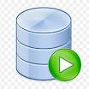

Design time connection to managed database in private subnet
ORACLE CLOUD DATA CENTER REGION (Frankfurt)
AVAILABILITY DOMAIN-1
AVAILABILITY DOMAIN-2
AVAILABILITY DOMAIN-3
10.0.10.6
Wkr Security List
DBHost
Regional Private SUBNET A,10.0.10.0/24
10.0.20.2
130.61.91.64
BastionHost
LB Security List
Regional Public SUBNET A,10.0.20.0/24
OKE VCN, 10.0.0.0/16
Medreck8s Compartment

Slide 77
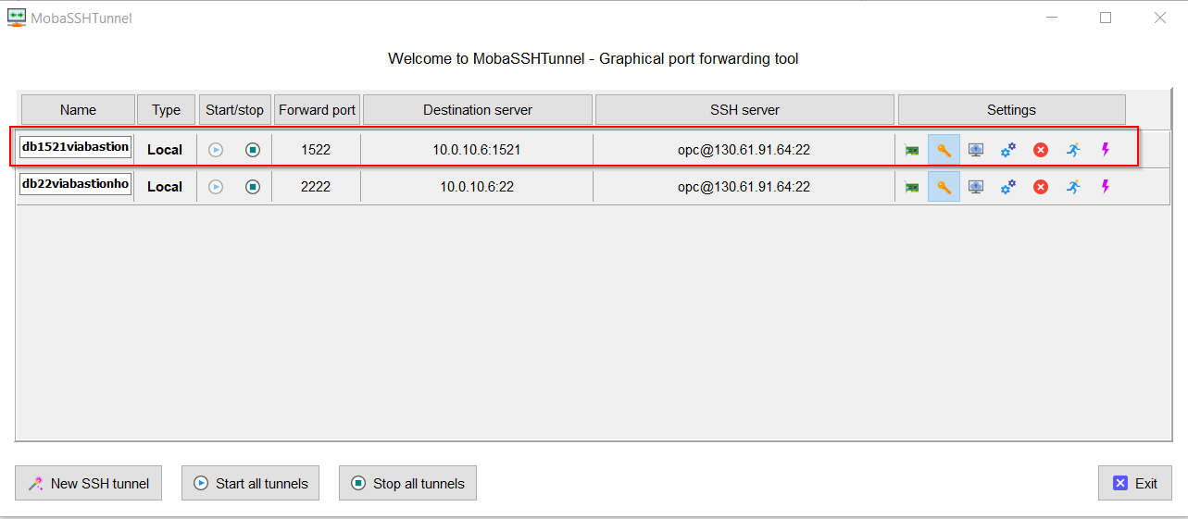
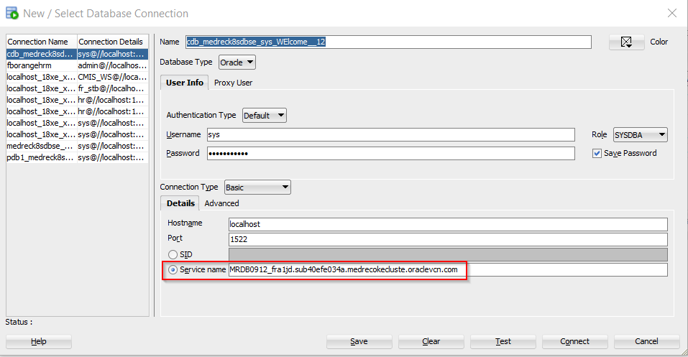
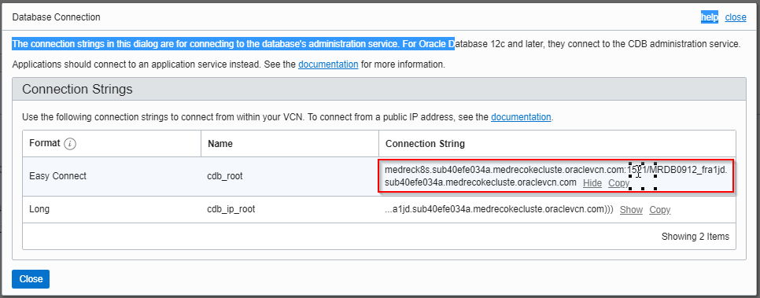
Design Time Connection (tunneling)

Slide 78
Network Security rules via additional security groups (next to security lists)
ORACLE CLOUD DATA CENTER REGION (Frankfurt)
Ingress:SecGrpBHIng|22
Egress:0.0.0.0/0|all
AVAILABILITY DOMAIN-1
AVAILABILITY DOMAIN-2
AVAILABILITY DOMAIN-3
SecGrpWL
SecGrpWL
SecGrpWL
AdmSrv
10.244.2.45
10.0.10.4
10.0.10.2
10.0.10.3
Srv-2
10.244.0.56
Srv-3
10.244.1.40
Srv-1
10.244.2.46
OKE-1
OKE-2
OKE-0
10.0.10.6
OKE Cluster
Ingres:SecGrpBH|1521
Ingres: SecGrpBHICMP
Ingres:SecGrpWL:1521
medrecdbhostname sk8s service op 1521
Wkr Security List
DBHost
SecGrpDB
Regional Private SUBNET A,10.0.10.0/24
Ingress:0.0.0.0/0|22 (SSH)
Ingress:0.0.0.0/03389 (RDP)
Ingress:0.0.0.0/0ICMP
10.0.20.2
130.61.91.64
BastionHost
SecGrpBH
LB Security List
130.61.12.8
LB
Regional Public SUBNET A,10.0.20.0/24
OKE VCN, 10.0.0.0/16
Medreck8s Compartment

Slide 79
Wrapping up…

Slide 80
Links
Oracle Weblogic Kubernetes Operator
https://oracle.github.io/weblogic-kubernetes-operator
Oracle Weblogic Kubernetes Operator Samples
https://oracle.github.io/weblogic-kubernetes-operator/samples/
Oracle Weblogic Slack Inviter
https://weblogic-slack-inviter.herokuapp.com/
Cloud Customer Connect – Containers and Kubernetes forum
https://cloudcustomerconnect.oracle.com/resources/654ff18469/summary
OPN PaasForum/SummerCamps ’19 Tutorial by Peter Nagy (to be forked)
https://github.com/nagypeter/weblogic-operator-tutorial
End2End example monitoring wl server with Grafana dashboards
https://blogs.oracle.com/weblogicserver/end-to-end-example-of-monitoring-weblogic-server-with-grafana-dashboards-on-the-oci-container-engine-for-kubernetes

Slide 81
Thank you for your attendance, patience and attention

Slide 82

Q & A

